Slide 1
The Rady School of Management
Lecture #3
Scanning the Marketing Environment
MGT 103 Product Marketing & Management
M,W 11:00 a.m. – 12:20 p.m., OTRSN 1S114
Professor Burt De Mill

Slide 2
SWOT Analysis – Selfridges – Group Work
Location of Factor
Type of Factor
Favorable
Unfavorable
Strengths
Weaknesses
Internal
Opportunities
Threats
external

Slide 3
Group Work – Selfridge’s SWOT Analysis You are the CMO…what next?
10 minutes
Present group thoughts

Slide 4
Key Talking Points for today…. (1 of 2)
How environmental scanning provides information about social, economic, technological, competitive, and regulatory forces.
Social forces such as demographics and culture can have an impact on marketing strategy.
Discuss how economic forces such as macroeconomic conditions and consumer income affect marketing.

Slide 5
Key Talking Points for today…. (2 of 2)
Describe how technological changes can affect marketing.
Discuss the forms of competition that exist in a market and the key components of competition.
Explain the major legislation that ensures competition and regulates the elements of the marketing mix.

Slide 6


FORTUNE’S BUSINESSPERSON OF THE YEAR: “I’M IN THIS TO BUILD SOMETHING COOL!”
Facebook:
CEO Mark Zuckerberg
1.8 Billion Active Users ~ 25% of World Population Environmental Forces Influence Facebook
Facebook in the Future?
Facebook Video
©David Paul Morris/Bloomberg via Getty Images

Slide 7
ENVIRONMENTAL SCANNING (1 of 2)
Environmental Scanning
What Trends Might Affect Marketing in the Future?
Examples:
Brand Advocates
Virtual Reality
Augmented Reality
“Gig” Economy

Slide 8
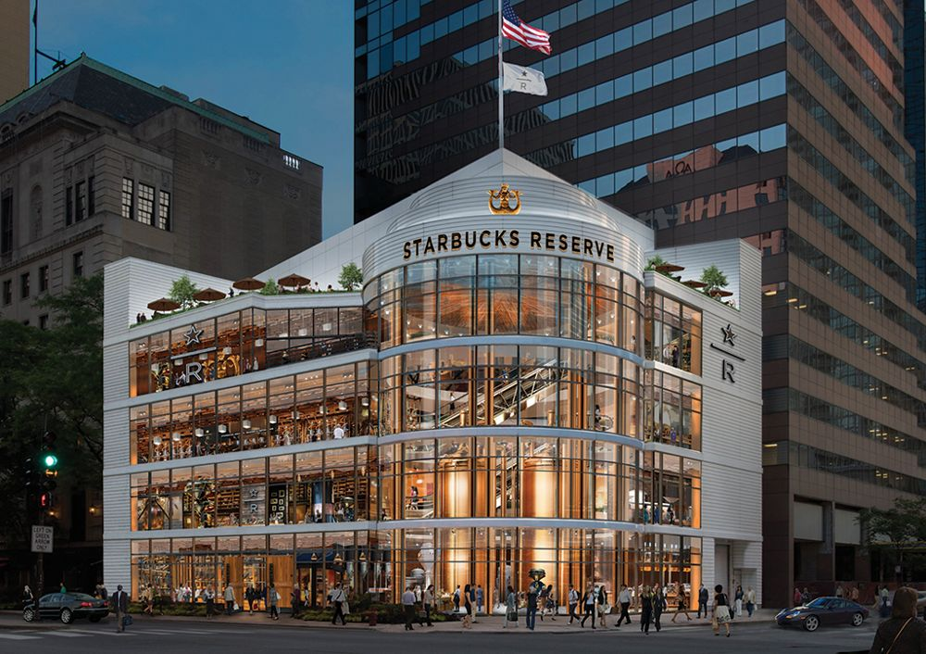
ENVIRONMENTAL SCANNING (2 of 2)
Ex: Coffee Industry
Regular Drinkers Declining
“Gourmet” Drinkers Increasing
Online Ordering
Cold Brew Coffee
Roastery Tasting Rooms
Coffee Bars
©Starbucks/Cover Images/Newscom

Slide 9
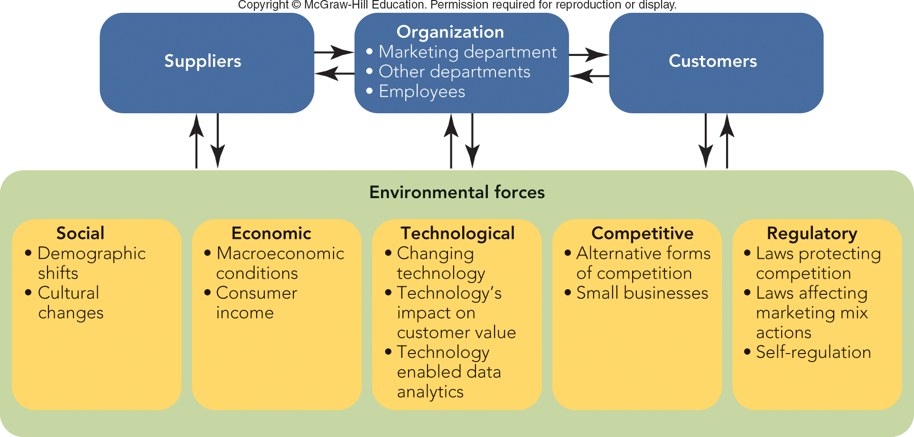
FIGURE 3-1 Environmental forces affect the organization, its suppliers, and its customers.
Jump to Appendix 1 long image description

Slide 10
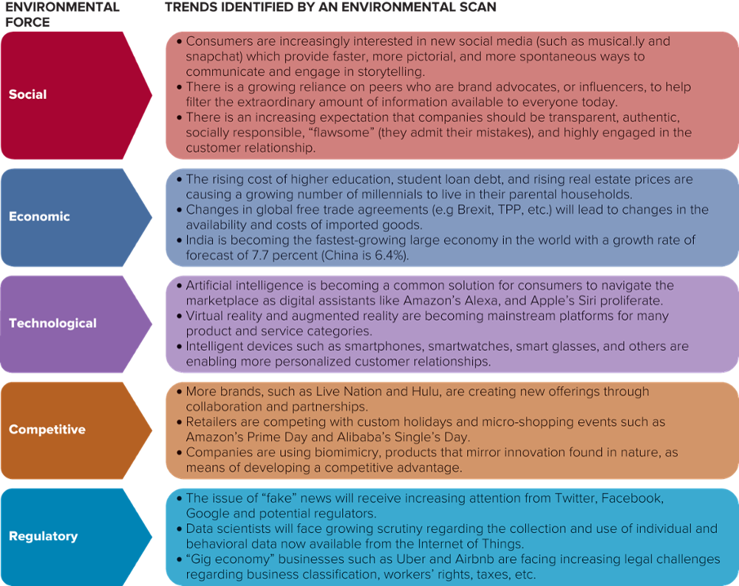
FIGURE 3-2 An Environmental Scan of Today’s Marketplace Shows Important Trends

Slide 11
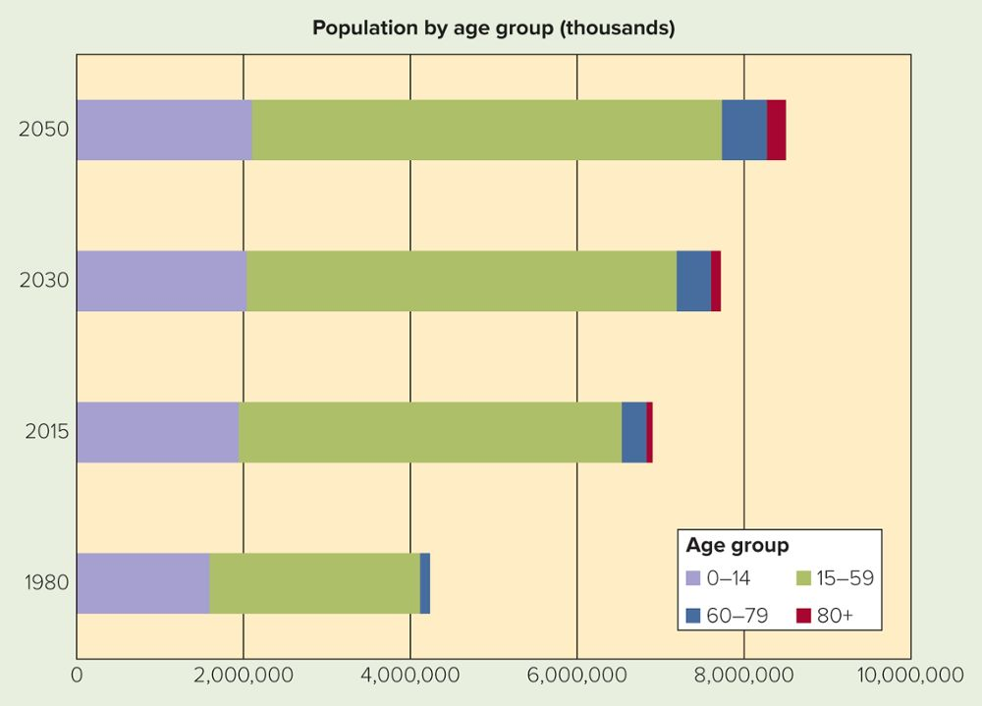
SOCIAL FORCES Population by Age Group (Thousands)
What Are the Implications of Changes in World Population?
Source: United Nations, Department of Economic and Social Affairs, Population Division

Slide 12
SOCIAL FORCES GENERATIONAL COHORTS
Baby Boomers: 1946 to 1964
Retiring at Rate of 10,000 Every 24 Hours
All Will Be 65+ by 2030
Generation X: 1965 to 1976
50 Million People
Generation Y (Millennials): 1977 to 1994
75 Million People
Generation Z: 1995 to 2010
Broadest Diversity

Slide 13
MAKING RESPONSIBLE DECISIONS PROFITS AND PURPOSE – MILLENNIAL STYLE
Expect Brands and Companies to Embrace Social Change, Corporate Social Responsibility, and Environmental Stewardship
Net Impact – a Nonprofit for Students Who Want to “Use Business to Improve the World”
Net Impact Website

Slide 14
SOCIAL FORCES THE AMERICAN HOUSEHOLD AND POPULATION SHIFTS
American Household Structure Has Changed
Regional Shift Toward Southern and Western States
Shifting Within States (30% in Cities, 50% in Suburbs, 20% in Rural)
Metropolitan Statistical Area: 50,000+ People
Micropolitan Statistical Area: 10,000 to 50,000 People

Slide 15
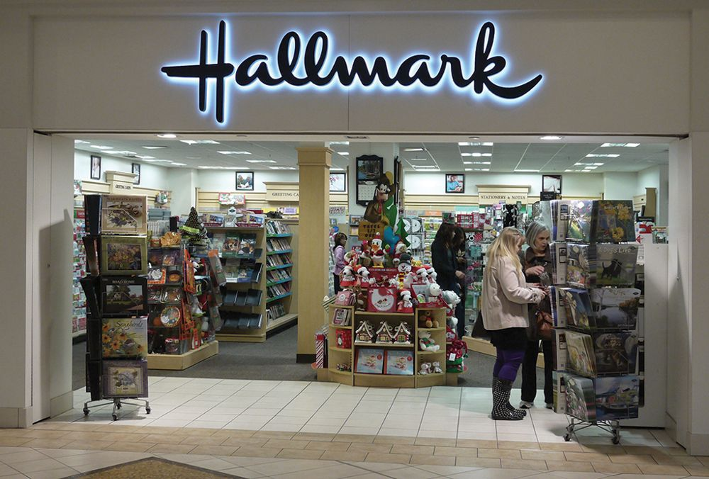
SOCIAL FORCES DEMOGRAPHICS—RACIAL AND ETHNIC DIVERSITY
Composition
Trends
African Americans
Hispanics
Asian Americans
Multicultural Marketing
U.S. Census Bureau
©products and brands/Alamy Stock Photo

Slide 16
SOCIAL FORCES CULTURE—CHANGING ATTITUDES OF MEN AND WOMEN
Notable Cultural Changes in Attitudes and Roles of Men and Women in the Marketplace
Careers
Sports
Technology

Slide 17

SOCIAL FORCES CULTURE—CHANGING VALUES
Culture:
Values, Ideas, and Attitudes Shared by Members of a Group
Values May Change Over Time
Value Consciousness
Colgate Super
Bowl Ad
©Ellen Isaacs/Alamy Stock Photo

Slide 18
ECONOMIC FORCES MACROECONOMIC CONDITIONS
Economy – Income, Expenditures, Resources
Macroeconomics – Performance of the Economy based on Indicators (Example: GDP, Inflation, Deflation, etc.)
Inflation – Production Costs and Prices Increase
Recession – Periods of Declining Economic Activity

Slide 19
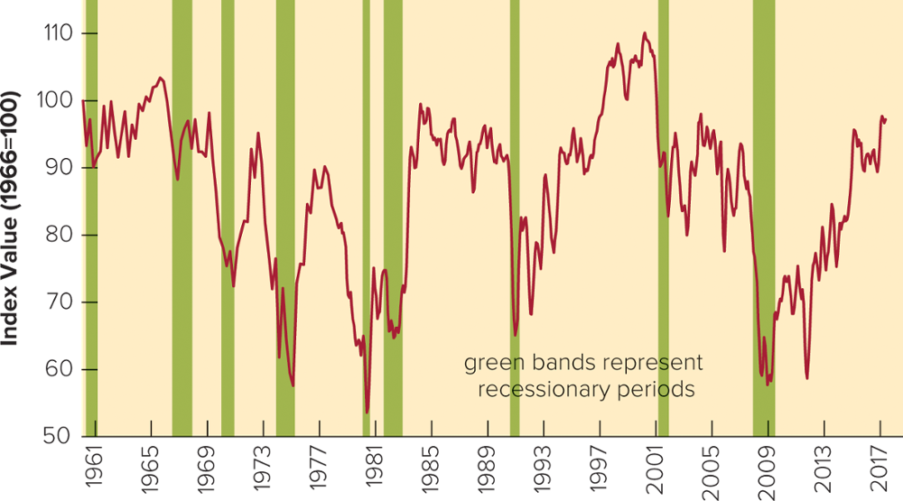
FIGURE 3-4 The Index of Consumer Sentiment (ICS) - Closely Related to Economic Conditions

Slide 20

ECONOMIC FORCES CONSUMER INCOME
Microeconomics – Ability of Consumers to Buy
Gross Income
Disposable Income
Discretionary Income
Courtesy of Cunard Line

Slide 21
MARKETING INSIGHTS ABOUT ME American FactFinder: Economic Information
Marketers Use Environmental Information to Better Understand Consumers
Environmental Scan to Compare Data About a Segment
What Does Your Hometown Look Like?
Fact Finder

Slide 22
TECHNOLOGICAL FORCES TECHNOLOGY OF TOMORROW
Technology
Artificial Intelligence Capabilities
Automation (Drones, Cars, Robots, etc.)
Internet of Things (IoT)
Wearable Technology

Slide 23
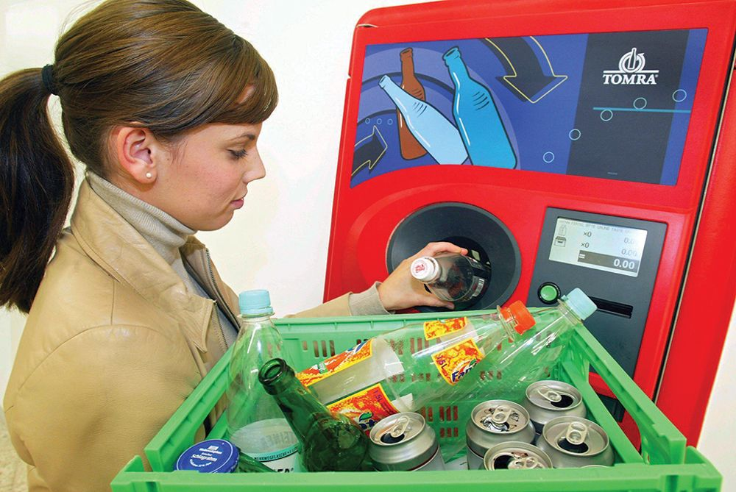
TECHNOLOGICAL FORCES TECHNOLOGY’S IMPACT ON CUSTOMER VALUE
Impact on Customer Value:
Plummeting Costs
New Focus on Quality, Service, Relationships
Thousands of New Products
Changes Production of Existing Products
Recycling
©dpa picture alliance/Alamy Stock Photo

Slide 24

TECHNOLOGICAL FORCES TECHNOLOGY ENABLES DATA ANALYTICS
Marketspace
Electronic Commerce
Internet of Things
5G
Minority Report
©Askold Romanov/Getty Images

Slide 25
COMPETITIVE FORCES ALTERNATIVE FORMS OF COMPETITION
Competition
Pure Competition – Many Sellers “price takers”
Monopolistic Competition – Many Sellers With Substitutable Products
Oligopoly – Few Sellers
Pure Monopoly – Only One Seller
Notes:
Pure Competition – commodities, corn, wheat
Monopolistic Competition- many sellers with substitutable products-corn, when, soft drinks)
Oligopoly- cable TV, cell service
Pure Monopoly- only one seller; Amazon, Apple, Google, Facebook

Slide 26
REGULATORY FORCES (1 of 2) PRODUCT-RELATED LEGISLATION
Product-Related Legislation:
Patent Law
Copyright Law
Digital Millennium Copyright Act (1998)
Infant Formula Act (1980)
Nutritional Labeling and Education Act (1990)
Fair Packaging and Labeling Act (1966)
Child Protection Act (1966)
Consumer Product Safety Act (1972)

Slide 27
REGULATORY FORCES PRICING-RELATED LEGISLATION
Pricing-Related Legislation:
Price Fixing – Illegal
Price Discounting – Certain Forms Are Allowed

Slide 28
MARKETING MATTERS Does Protecting Privacy Hurt the Web?
Many Consumers Are Unaware that Their Actions Are Tracked to Create Profile of Their Interests (Online Behavioral Targeting)
Advertisers Match Advertising Just for You
FTC Suggests “Do Not Track Option”
Is Legislation Needed?
FTC Privacy
Website

Slide 29
Announcements/Reading Assignments………
Chapter #4
Review Case Study #1, Mary Barra @ GM
Office hours today at 1:30 – 3:30 p.m.
2N108 Rady Undergrad
See you on Wednesday!

Slide 30
The Rady School of Management
Lecture #3
Scanning the Marketing Environment
MGT 103 Product Marketing & Management
M,W 11:00 a.m. – 12:20 p.m., OTRSN 1S114
Professor Burt De Mill

Slide 31

VIDEO CASE
GEEK SQUAD: A NEW BUSINESS FOR A NEW ENVIRONMENT
Geek Squad Video Case

Slide 32
VIDEO CASE
Geek Squad at Best Buy
What are the key environmental forces that created an opportunity for Robert Stephens to start the Geek Squad?
What changes in the purchasing patterns consumers made the acquisition of Geek Squad particularly important for Best Buy?
Based on the case information and what you know about consumer electronics, conduct an environmental scan for Geek Squad to identify key trends. For each of the five environmental forces (social, economic, technological, competitive, and regulatory), identify trends likely to influence Geek Squad in the near future.
What promotional activities would you recommend to encourage consumers who currently use independent installers to switch to Geek Squad?

